Slide 1






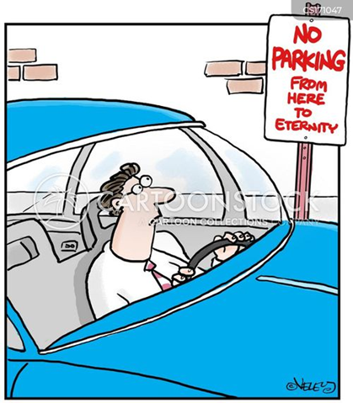
Problem Statement:
Online Slot Booking Platform
Presentation By:
Sreshtha Das
Tanir Sahoo
Manash Das

Slide 2
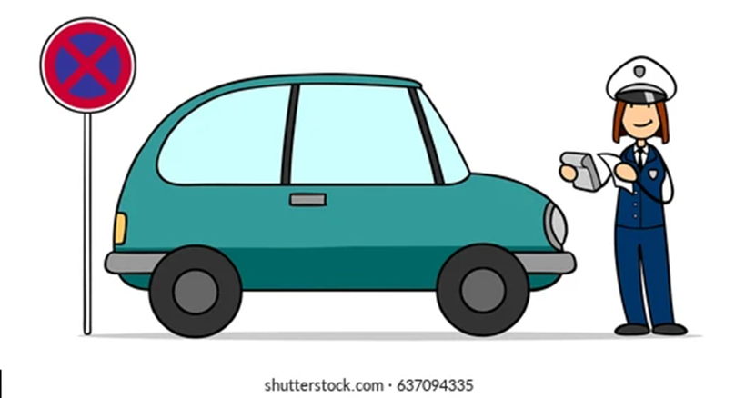
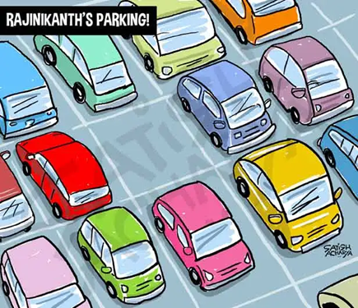
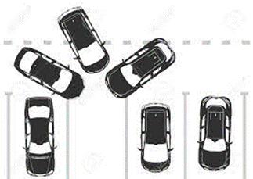
Current Challenges in Parking Systems:
Unnecessary Fines
Towing
Traffic Congestion
Drivers competing for the same spots.
Inefficient parking management.

Slide 3

Customer initiates registration by providing details such as customer id, phone number, address, password, car number, and name. Upon registration, an Account is created with attributes including account name, account id, and linked customer details. The Customer can search for available Parking Spaces, characterized by attributes such as capacity, status, space name, price, availability, and disabled. Upon selecting a Parking Space, the Customer can make a Booking, generating a booking id and capturing details like customer name, customer id, car details, booking status, arrival, and departure times.
Malls and restaurants can effectively reduce chaos during peak hours, ensuring a seamless experience for their customers by pre-booking parking spaces
By leasing out the parking spaces through the app, the establishments with their own parking facilities can efficiently manage their resources while reducing manual labour costs associated with traditional parking management systems.
In cases where users exceed their booked time slots, the system may implement automated mechanisms to charge penalties. Users may have the option to extend their parking duration, provided there is availability.
WORKING:

Slide 4
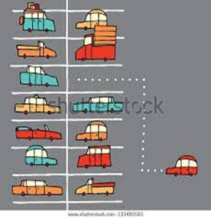
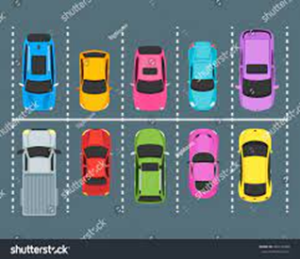
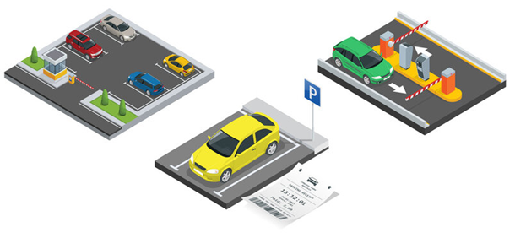
After using our platform:

Slide 5
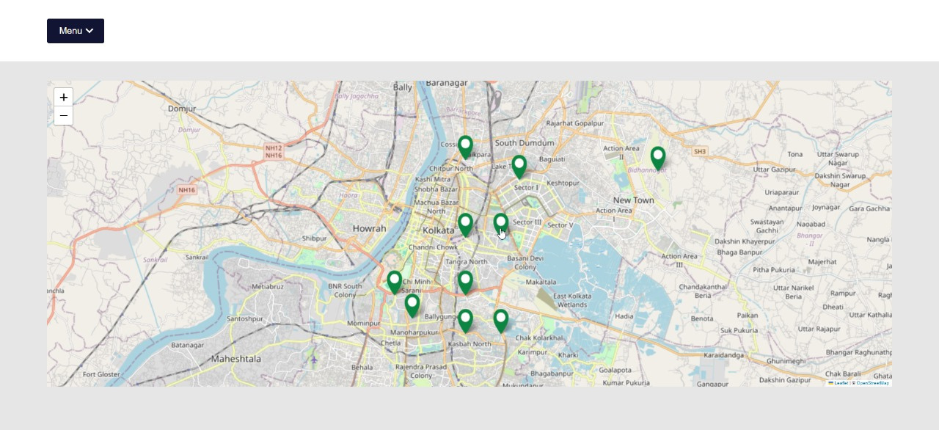
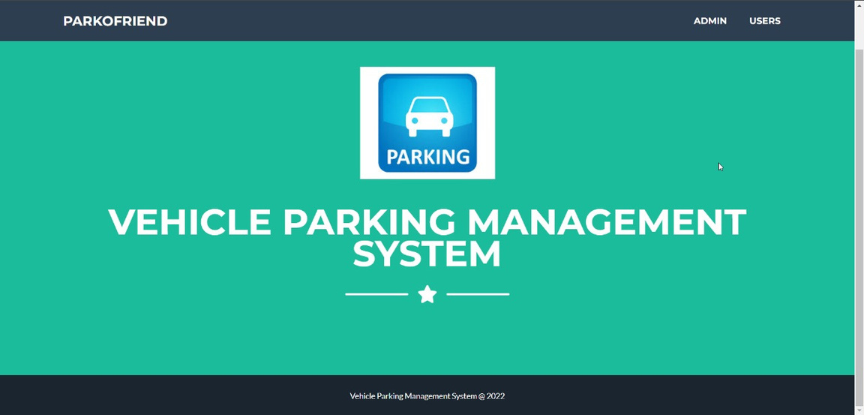
This map is designed to provide users with a visual representation of their current location and nearby areas with available parking spaces. Upon opening the app, there are markers or icons representing parking areas within the vicinity. To book a parking slot, users simply select the desired area on the map where they intend to park.
After choosing a parking area on the map, users are directed to a page where they are prompted to identify themselves as either an administrator or a regular user. Then they have to login/sign-up. Upon successful authentication, users are granted access to their personalized dashboard or profile within the app, where they can manage their parking bookings, view transaction history, and adjust account settings as needed. Additionally, administrators have access to enhanced features and privileges, allowing them to oversee parking operations, monitor occupancy levels, and manage user accounts and permissions effectively.

Slide 6
Business Prospect:
Revenue Generation:
- Booking Fees: Charge users a fee for each parking slot reservation made through the app. The fee can vary based on factors such as location, time of day, and duration of parking.
- Premium Slots: Offer premium parking slots with added conveniences such as proximity to entrances or enhanced security features at a higher price point.
- Advertisements: Partner with local businesses or third-party advertisers to display targeted advertisements within the app. Ad revenue can be generated based on impressions or clicks.
- Partnerships: Collaborate with parking facilities, commercial complexes, or event organizers to offer exclusive deals or discounts to app users. Revenue can be generated through revenue-sharing agreements or service fees.
- Additional Services: Explore opportunities to upsell additional services such as car wash, valet parking, or electric vehicle charging. These services can provide an additional revenue stream and enhance the overall user experience.
- Data Monetization: Utilize data analytics to gather insights into parking demand patterns, user behavior, and preferences. Aggregate and anonymize data to offer valuable insights to urban planners, businesses, or transportation authorities for a fee.
Table of charge ex:
Plan for space owners:
Market Analysis: Conduct thorough market research to understand the demand for parking solutions in target areas. Identify key demographics, competition, and trends in parking behavior. Urban areas with high population density and limited parking options present significant opportunities.
User Acquisition and Retention: Develop strategies to attract users to the app, such as offering incentives for first-time bookings or referral programs. Focus on user experience to encourage repeat usage and build brand loyalty. Providing seamless booking processes and reliable customer support are essential for retaining users.
Technology and Infrastructure: Invest in robust technology infrastructure to ensure the app's reliability, security, and scalability. Implement features such as real-time availability updates, navigation assistance, and secure payment gateways to enhance user satisfaction and trust.
Regulatory Compliance: Stay abreast of local regulations and compliance requirements related to parking operations, data privacy, and payment processing. Ensure that the app adheres to relevant laws and standards to avoid legal issues and maintain trust among users and partners.
Marketing and Promotion: Develop a comprehensive marketing strategy to raise awareness and drive app downloads. Utilize digital marketing channels such as social media, search engine optimization (SEO), and targeted advertising campaigns. Collaborate with local influencers or community organizations to amplify reach and credibility.
What Make’s us Different:
Time saving
Hustle free parking slot booking
Maximum optimization of the parking space
Hours | Interest | Hour specific charge | Total payable
1 | 0% | 20.00 | 20.00
2 | 10% | 22.00 | 42.00
3 | 10% | 24.20 | 66.20

